Slide 1
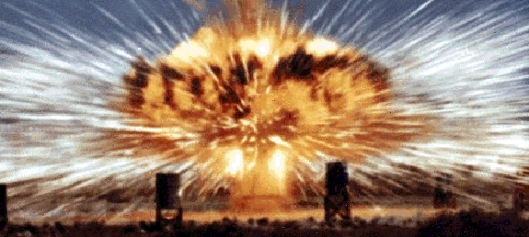
Conducting Ethical Risk Assessments when Uncertainty Exists Connecticut River Valley AIHA Chapter Jan K. Wachter, ScD, MBA, CSP, CIH
September 20, 2023

Slide 2
ISO-45001 Definition of Risk
RISK
effect of uncertainty
Note 1 to entry: An effect is a deviation from the expected — positive or negative.
Note 2 to entry: Uncertainty is the state, even partial, of deficiency of information related to, understanding or knowledge of, an event, its consequence, or likelihood.

Slide 3
The Ethical Dimension of Defining Risk Acceptance Criteria
The field of ethics is concerned with distinguishing between right and wrong actions and behaviors.
Risk acceptance criteria distinguish between levels of risk that are acceptable and that which is intolerable.
In a sense, risk acceptance criteria distinguishes between “good” and “bad” systems, activities and potential outcomes with respect to risk.
So, there is a distinct ethical dimension when conducting risk assessments and establishing risk acceptance criteria.

Slide 4
Roles / Questions
Individual’s roles often establish one’s ethical duties
Role of health and safety professional is to protect workers “so far as is reasonably practicable”; provide reasonable care
How do you determine what is reasonably practicable?
Experience
Knowledge
Tradition
Cost-benefit analyses
Cost/benefit analyses – are these ethical approaches?
The tipping point for cost/benefit analyses: there will be monetizing of pain and suffering
Risk-benefit analyses

Slide 5
What Are Reasonably Practicable Actions?
Determining the meaning of ‘reasonably practicable’ for an EHS professional’s decisions requires consideration of factors characterized by:
Uncertainty as to the extent of severity of potential consequences, people who might be affected, and the likelihood of the consequences occurring from our actions (sounds like a risk assessment!)
The more uncertain → the less reasonable the action becomes (reckless)
The more uncertain → calls for more conservative decisions (prudence)
What is the result of inaction?
Competing values in determining whether the cost of control or implementing an EHS program (borne by the organization) is grossly disproportional considering benefits received (to workers and others).
Regulations
Professional Codes of Ethics

Slide 6
Ethics and Risk Assessments/Treatments
What is considered reasonably practicable when conducting risk assessments/treatments?
Two concepts are used in conducting assessments for managing risk with ethical implications:
ALARP – reduce risk to “as low as reasonably practicable.” What really is ALARP?
Reduce risk to acceptable levels. What is the level of acceptable risk?
Acceptable to whom?
The SHE professional
Fellow SHE professionals
Managers
Supervisors
Employees
Regulators
Courts
Public
Shareholders

Slide 7
Achieving “acceptable risk levels”
The primary purpose of the safety management system (Z10) standard is to provide a management tool to reduce the risk of occupational injuries, illnesses and fatalities – but what risk reduction level is to be achieved from an ethical perspective?
Unacceptable answer: “zero” risk level (why is this unacceptable?)
Acceptable answer?: that which is acceptable to management
Is this what is meant by As Low as Reasonably Practical (ALARP)? Achieving acceptable risk levels?
Does ALARP determine acceptable risk? (1)
Does acceptable risk determine ALARP? (2)
Are ALARP and acceptable risk the same? (3)
Or is it none of the above? (4)

Slide 8
SMS ACCEPTABLE RISK / ALARP
ACCEPTABLE LEVEL OF RISK (November 2018 draft of Z10): That level of risk which can be further lowered only by an increment in resource expenditure that cannot be justified by the resulting decrement of risk. Note: This is a typical definition as “as low as reasonably practicable (ALARP)”.
Loss prevention / cost perspective
ACCEPTABLE LEVEL OF RISK (2019 Z10 version): The level of risk to workers, resulting from exposure to hazards or system deficiencies, that is tolerated by management
ACCEPTABLE LEVEL OF RISK (OHSAS 18001): Risk that has been reduced that can be tolerated by the organization having regard to its legal obligations and its own OH&S policy
ACCEPTABLE LEVEL OF RISK (ANSI/ASSE Z590.3-2011 – Prevention through Design): That risk for which the probability of an incident or exposure occurring and the severity of harm or damage that may result are as low as reasonably practicable (ALARP) in the setting being considered
ACCEPTABLE LEVEL OF RISK (ISO-45001): No definition

Slide 9
Ethical ALARP
ALARP decisions typically come at the end of conducting risk assessments → moving into a risk treatment process to determine “residual risk” (What is an ethical amount of acceptable residual risk?)
Often calls for implementing actions that cannot be justified by conducting straight forward cost-benefit analysis – what other factors need to be considered?
Calls for implementing activities whose costs may be disproportional to benefits based on context/circumstances
If this is the case, under what circumstances would you implement activities whose costs are grossly disproportional to benefits? Could it have something to do with achieving acceptable risk levels? Managing societal risk? Managing involuntary risk?

Slide 10
Ethical ALARP
Effect of uncertainty on determining ALARP
When risk analyses have much uncertainty and/or lack of knowledge associated with them, ALARP should become more “aggressive” (e.g., implement risk treatment activities whose costs are grossly disproportional to benefits)
What is the strength of knowledge or information being used to determine risk? Do you have the ethical responsibility to pursue more knowledge to conduct better risk assessments?
Uncertain environments → invoke “precautionary principles” → leads to decision-making conservatism and aggressively pursuing ALARP
Has ALARP been slowly evolving over time into ALARA?

Slide 11
Ethical ALARP
What do you pragmatically need to consider when establishing an ethical ALARP?
Objective, practical things can be pursued when establishing an ethical ALARP:
Meeting or exceeding regulatory requirements
What is considered best in industry
Adhering to company’s best management practices and consensus standards
Having deference to using EHS expertise to impart knowledge and experience in these deliberations
Professional association guidance
Technical feasibility
Level of uncertainty in outcomes (probability and severity)
Level of uncertainty of inputs into the risk analyses

Slide 12
ALARP and ACCEPTABLE RISK
ALARP and ACCEPTABLE RISK are related – but different
Does implementing ALARP principles always arrive at acceptable risk levels? The answer is “no.” Many organizations conflate the two. Organizations often self-design their risk management processes stating that if ALARP is a goal to be achieved, the resulting risk is acceptable. This is the easy approach and may be unethical in some situations.
ALARP → more of a technical feasibility / cost construct → EH&S professionals and technical managers often determine/recommend this
Versus
Acceptable risk → more of a value judgment which is strategically driven, ethically driven, an organizational concept (higher level concept) → managers should determine this (for accountability reasons)
“Who” makes the decision may differentiate ALARP and Acceptable Risk

Slide 13
ACCEPTABLE RISK
Acceptable risk should take into consideration viewpoints from multiple stakeholders: reputation risk, financial risk, stakeholder perceptions, etc. should be viewed along with EHS risk → enterprise risk proposition
Of course, acceptable risk should be viewed through the lens of regulatory compliance (and perhaps ALARP) as a minimum ethical strategy
Reiteration: Acceptable risk also needs to factor in uncertainty and level of knowledge.
Acceptable risk levels should be lowered when facing more uncertainty or lack of knowledge (cautionary/precautionary principle) – or dealing with potential consequences when viewed as being intolerable (even if ALARP is applied).

Slide 14
Risk Appetite
Are there ethical limits to an EHS professional’s risk appetite when helping to make these decisions?
Professional (safety and health) ethics can invoke much higher standards than other professions, calling on professionals to strive for excellence, integrity and expertise, and to do things that really make a difference → is it our duty to do so?
Ethics has the otherness orientation (consequentialism)
How do your actions affect others (versus yourself)? (otherness orientation)
How are your actions viewed through the eyes of others? (otherness orientation)
Golden rule: do unto others as they would do unto you
The Kantian categorical imperative (deontology): Kant defines categorical imperatives as commands or moral laws all persons must follow, regardless of their desires or extenuating circumstances. As morals, these imperatives are binding on everyone
Duty to be knowledgeable? Duty to be transparent? Duty to state what you know and don’t know? → LOOK AT CODES OF PROFESSIONAL CONDUCT (ASSP, BCSP, AIHA, Board of Global EHS Credentialing)
Ethics of Care

Slide 15
RISK MATRICES
Results of risk matrices often help drive ALARP and acceptable risk decisions
But in a risk matrix, what criteria are being used to determine if something is low risk, medium risk, high risk? Is a “seat-of-your-pants” or “gut-level” approach to risk classification an ethical approach? What criteria are being used to define probability and severity levels? Are you confident in how these levels are defined? Are you confident in having accurate information to classify activities according to these levels?
Is risk just the rather arbitrary intersection of severity and probability? Are risk levels a rather imprecise coding of the “intersection” boxes?
So much uncertainty out there…not to be conservative from an ethical perspective
So much complexity out there…not to have to conduct more complicated/insightful risk assessments…beyond using a two-dimensional risk matrix

Slide 16
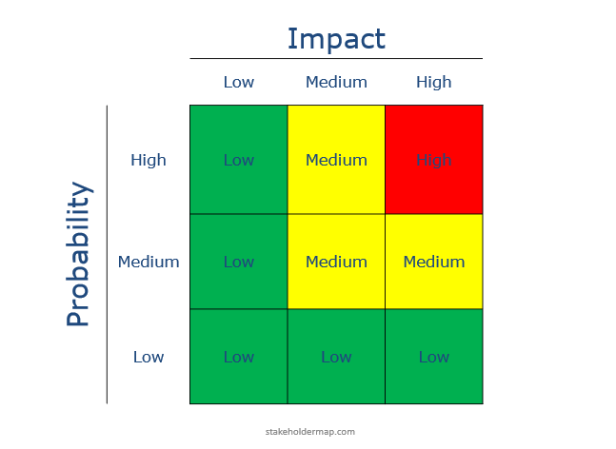
HOW DO YOU DETERMINE THE CRITERIA?
HOW DO YOU DETERMINE THE RISK CATEGORIES?
HOW DO YOU DETERMINE THE CRITERIA?

Slide 17
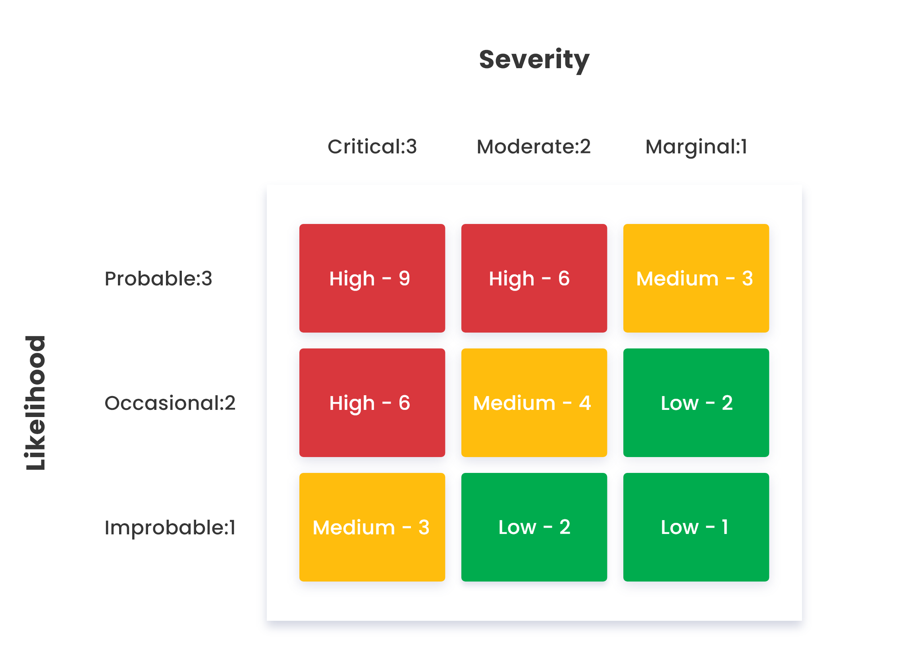
Low – 1,2,3?
Medium – 4,5,6?
High – 7,8,9?

Slide 18
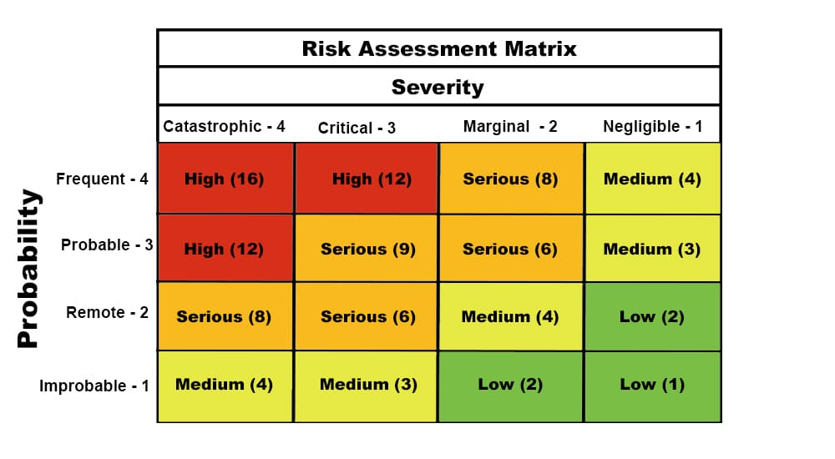
Low – 1,2,3,4?
Medium – 5,6,7,8?
Serious – 9,10,11,12?
High – 13,14,15,16?

Slide 19
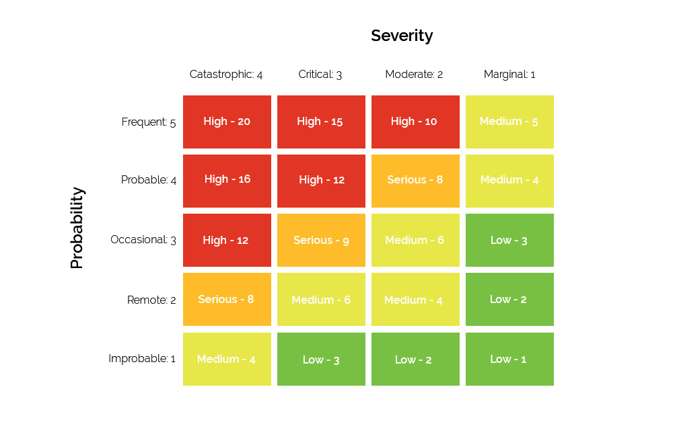
Low – 1,2,3,4,5
Medium – 6,7,8,9,10
Serious – 11,12,13,14,15
High – 16,17,18,19,20

Slide 20
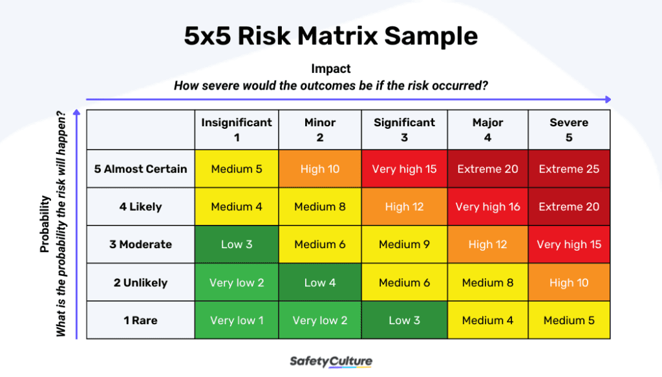
Very Low – 1,2,3,4?
Low – 5,6,7,8?
Medium – 9,10, 11,12?
High – 13,14,15,16?
Very High – 17, 18, 19, 20?
Extreme – 21,22,23,24,25?

Slide 21
ANSI / AIHA Z10 Risk Assessment Matrix Severity of Injury or Illness Consequence and Remedial Action (2-DIMENSIONAL MATRIX)
Likelihood of Occurrence | CATASTROPHIC | CRITICAL | MARGINAL | NEGLIGIBLE
For selected Unit of Time or Activity | Death or permanent total disability | Disability in excess of 3 months | Minor injury, lost workday accident | First Aid or Minor Medical Treatment
Frequent Likely to Occur Repeatedly | HIGH | HIGH | SERIOUS | MEDIUM
 | Operation not permissible | Operation not permissible | High Priority action | Take Remedial Action at Appropriate time
Probable Likely to occur several times | HIGH | HIGH | SERIOUS | MEDIUM
 | Operation not permissible | Operation not permissible | High Priority action | Take Remedial Action at Appropriate Time
Occasional Likely to occur sometime | HIGH | SERIOUS | MEDIUM | LOW
 | Operation not permissible | High Priority action | Take Remedial Action at Appropriate Time | Risk Acceptable: Remedial Action Discretionary
Remote Not likely to occur | SERIOUS | MEDIUM | MEDIUM | LOW
 | High Priority action | Take Remedial Action at Appropriate Time | Take Remedial Action at Appropriate Time | Risk Acceptable: Remedial Action Discretionary
Improbable may assume exposure will not happen | MEDIUM | LOW | LOW | LOW
 | Take Remedial action at appropriate time | Risk Acceptable: Remedial Action Discretionary | Risk Acceptable: Remedial Action Discretionary | Risk Acceptable: Remedial Action Discretionary

Slide 22
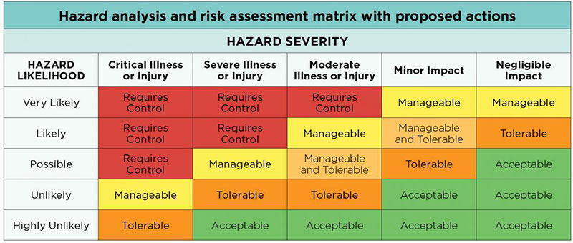
Acceptable risk defined

Slide 23
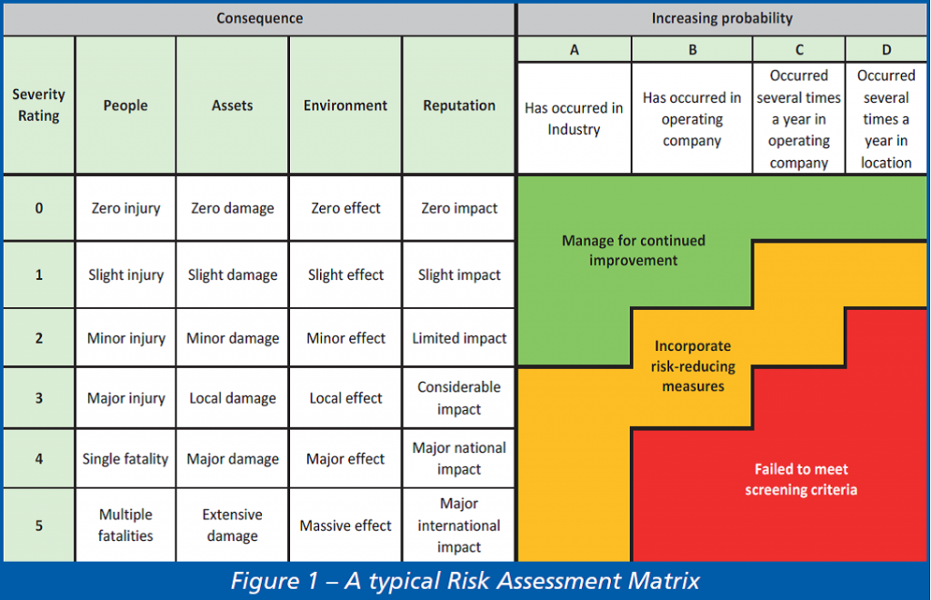

Slide 24
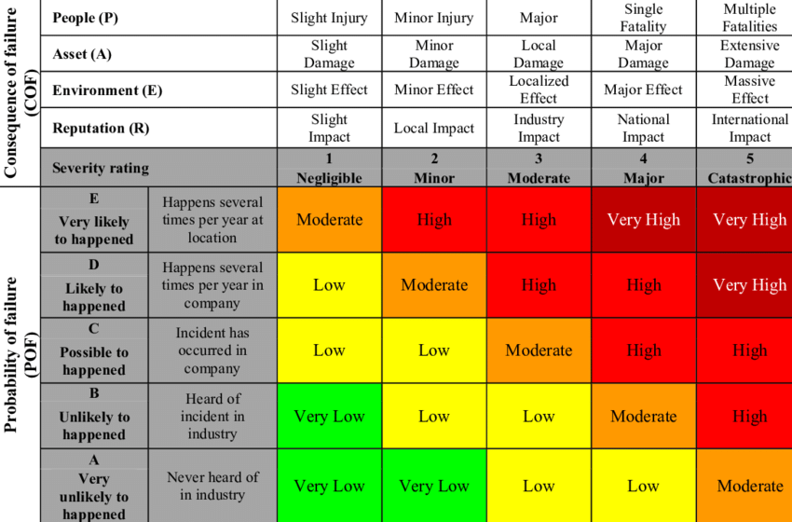

Slide 25
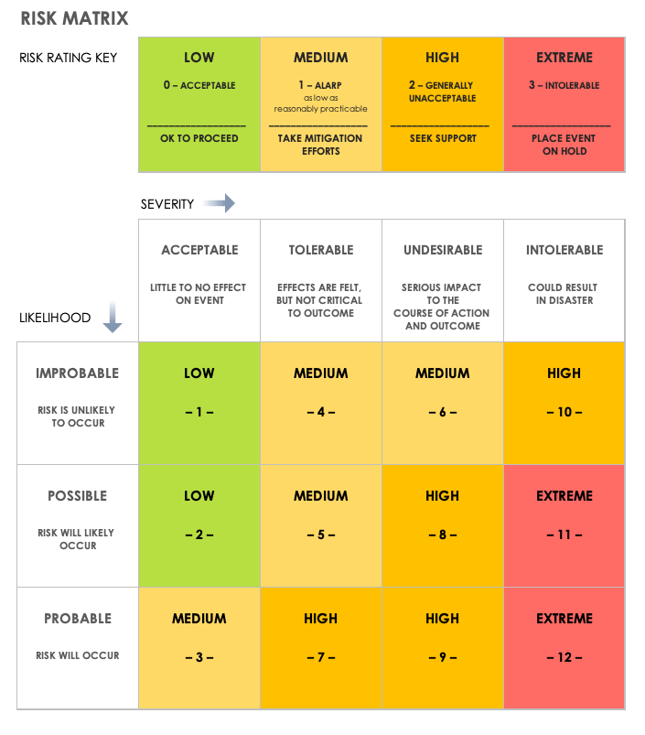

Slide 26
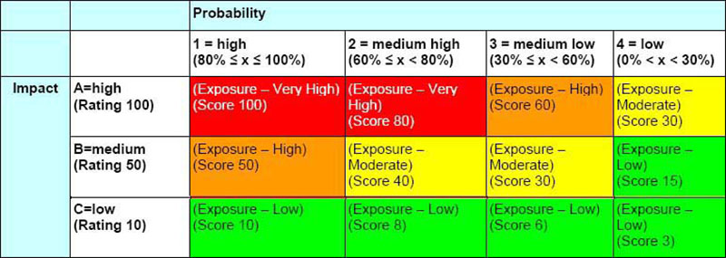

Slide 27
Societal Risk Acceptance Criteria
For large systems exposing large numbers of people to risks, and where large numbers of people are affected by possible accidents, societal risk acceptance criteria are deemed to be the most appropriate. In general, societal risk is expressed in terms of frequency versus number of fatalities.
FN-curves

Slide 28
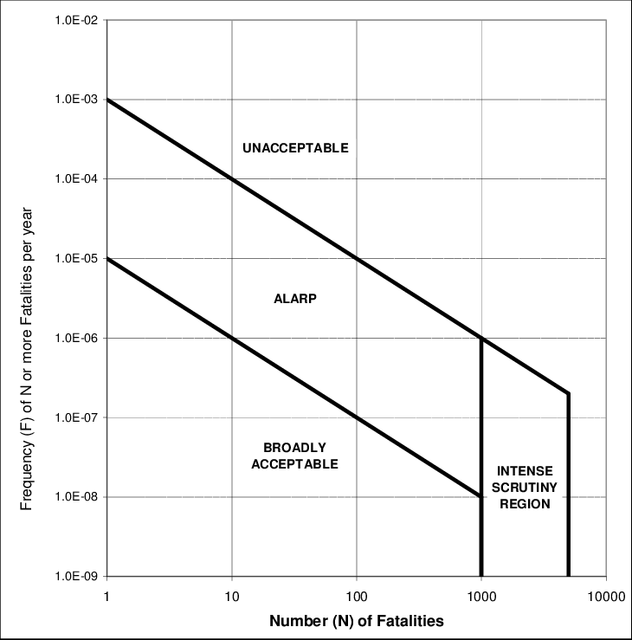
Anchor point
Anchor point

Slide 29
Individual risk acceptance criteria
It is often suitable to consider an exposed individual (i.e., an imaginary person that is exposed to hazards imposed by the system) when determining risk acceptance criteria
Consequences: death, injuries, and illnesses
Level of risk described as the probability of outcomes per some appropriate exposure measure (e.g., work-hours, travel distances, number of times task is performed)
Additional factors need to be considered in this determination:
The detectability of the hazardous event
The variability of the hazardous event
The uncertainty associated with probability or impact
The controllability of the hazardous event
The degree of user or bystander susceptibility to injury
The voluntary nature of the exposure
The fragility of the system
Any other ideas?
Hhhm. By only using a traditional 2-dimensional (severity and frequency) risk matrix in conducting risk assessments, is this an unethical approach since it tends to be limited in the factors being considered?

Slide 30
Principles for Establishing Risk Acceptance Criteria
Absolute risk criteria
ALARP principle
Principle of equivalency
Principle of maximum benefit to all
Holistic principle
Precautionary principle
Principle of parsimony
Combination of principles
Absolute probabilistic risk criteria together with ALARP principle
Above principles for establishing risk acceptance criteria can be justified/based on these ethical principles:
Deontology (duty, obligation) → duty to protect
Consequentialism → consequences of your analyses and decisions matter
Cost-effective criteria
Cost of averting a fatality (versus cost of a human life)

Slide 31
Verdict
Often, we think risk matrices as being “quantitative.” Really, it is probably more of an attempt to quantify uncertainty in an easy, numerical, visual manner. By putting a number to it, it becomes more “certain” and seems rigorous. But these numbers have a lot of uncertainty to them.
Solution: Use risk matrices/algorithms having many components reflecting your understanding of risk “drivers” for your industry/project/task.
Solution: Use qualitative risk assessments for describing risk along with the above.

Slide 32
Black Swan Events
A black swan is an unpredictable event that is beyond what is normally expected of a situation and has potentially severe consequences. Black swan events are characterized by their extreme rarity, severe impact, and the widespread insistence they were obvious in hindsight
Extreme level of uncertainty
How should risk assessments deal with these black swan events?

Slide 33
Black Swan Events
Known knowns → should be analyzed in risk assessments
Known unknowns → should be used to estimate degree of uncertainty in risk assessments, leading to aggressive risk treatment
Unknown knowns → supports the notion that you need to cast your net wide in conducting risk assessments to obtain as much information as you can (from others, other sectors, etc.)
Unknown unknowns → ??????

Slide 34
The question that should keep EHS professionals up at night:
Are there fatal / severe accident scenarios that would be caused by a configuration or conglomeration of unique / improbable factors that their risk cannot be defined?

Slide 35
From Nassim Taleb’s book Antifragility
“It is far easier to figure out if something is fragile than to predict the occurrence of an event that may harm. Fragility can be measured; risk is not measurable (outside the casinos or the minds of people who call themselves “risk experts”). This provides a solution to what I’ve call the Black Swan problem – the impossibility of calculating the risk of consequential rare events and predicting their occurrence. Sensitivity to harm from volatility is tractable, more so than forecasting the event that would cause the harm. We propose to stand our current approaches…to risk management on its head.”
Should prediction and risk management (given so much uncertainty) be replaced by processes moving us from fragility to antifragility?
Robust systems
Resilient systems
Antifragile systems

Slide 36
Ethics, Reason, Justification and Emotion: Their Relationship?
Ethics is based on reason. What would a reasonable person (EHS professional) do (in a specific context)? What is reasonably practicable to do when faced with risk? What is a reasonable amount of risk to accept?
Ethics is a mental exercise! You use your mind, not your heart or gut.
You need to be able to justify your risk decisions to employees, managers, stakeholders, regulators, public etc. → there are a lot of moral “objects” in our profession. The court of public opinion? (In this weird age we’re in, everything is permitted, until it’s not when you get caught, and then there is all justice, no mercy). The court of your professional peers? → probably an important group to consider when justifying the reasonableness of your decisions and risk assessments
Justification: Why did you choose the risk treatment? What is your intent? Why do you consider your risk treatment ALARP? Why do you consider the residual risk as being acceptable risk?
You rely on the best information you have available for analyzing the situation and making ethical decisions. Ignorance is not ethical bliss!
The presence of uncertainty requires risk assessments to be conservative or requires you to find and use additional information to reach your decisions.

Slide 37
New Definition of Risk
RISK:
presence of uncertainty potentially leading to the lack of planning or lack of control required to reduce risk to acceptable levels

Slide 38
THE ROLE OF UNCERTAINTY IN DETERMINING RISK (VILLANELLE POEM GENERATED BY CHATGPT)
But despite our efforts, it's always here,
The unknown factor that we can't foresee,
Uncertainty's role in risk is clear.
It lurks in the shadows, forever near,
And tests our courage and bravery,
It keeps us cautious, brings us fear.
We face it head-on, without any jeer,
For it's the only way we can guarantee,
That uncertainty's role in risk is clear,
It keeps us cautious, brings us fear.
Uncertainty's role in risk is clear,
It shapes the outcomes that we see,
It keeps us cautious, brings us fear.
We must accept that risks are near,
And plan for all that could be,
Uncertainty's role in risk is clear.
We measure and analyze, year to year,
With the goal to keep danger free,
It keeps us cautious, brings us fear.

Slide 39
Contact Information
Dr. Jan K Wachter, CIH, CSP
Professor, Safety Sciences
Indiana University of Pennsylvania
Jan.Wachter@iup.edu
724-357-3275

