Slide 1
Combating Combustible Dust in the Workplace
Jeff Krause
HA-International, LLC

Slide 2
Overview
Fundamentals; getting a feel for combustible dust hazards
Identify and classify
Key References
Look, we’ve been doing it this way for 30-years…
Dust Hazard Analysis
Process equipment, including dust collectors and bucket elevators
Housekeeping
Managing accumulations

Slide 3
Identify and Classify
Material
Often but not always organic, or metal
Small particle size, < 420 um
Flash fire or explosion when suspended in air and ignited

Slide 4
Common combustible dusts (NOT an exhaustive list)
Agricultural products – sugars, starches, flour, whey, wood flour, powdered milk
Agricultural dusts – plant processing dusts, starches, spices, food processing dusts
Carbonaceous dusts – soot, carbon black, coal, coke
Chemical dusts – calcium stearate, paraformaldehyde, adipic acid, sulfur, many others
Textile dusts – wool, silk, synthetic fibers
Metal dusts – aluminum, bronze, magnesium, zinc
Plastic dusts – LDPE, epoxy resins, phenolic resins, melamine resins, PVA, PVC, many others

Slide 5
Testing your material
Sampling
1-2 lb sample for full characterization, Ziploc bag typically acceptable
Collector filter, ceiling/beams, floor, equipment surfaces
Testing
Screening
Go/No Go
ASTM E1226
Explosion Severity – Kst and Pmax – needed for explosion prevention design, used for classification
Other characteristics

Slide 6
Kst Classes
St 0 0 bar.m.s-1 Does not explode
St 1 1 to 200 bar.m.s-1 Weak explosion
St 2 201 to 300 bar.m.s-1 Strong explosion
St 3 > 300 bar.m.s-1 Very strong explosion

Slide 7
Other tests
MIE – Minimum ignition energy
MEC – Minimum explosible concentration
Minimum autoignition temperature
Layer ignition test
Where to send the samples for analysis?
Is it okay to ship combustible dust samples?

Slide 8
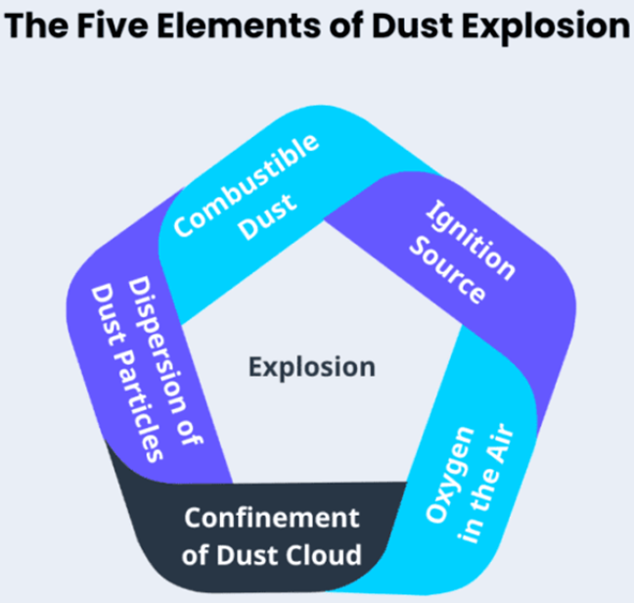
Criteria for a combustible dust explosion
Dispersion in air
Very high concentrations, not typical process/exhaust levels
MEC (phenolic resin) 15 g/m3
Ignition Source - MIE
More energy needed than flammable vapors, but still can be ignited by some forms of static discharge
Dusts
Aluminum 10 mJ
Epoxy Resin <10 mJ
Milk Powder 50 mJ
Phenolic Resin 2-10 mJ
Sugar 30 mJ
Versus Vapors
Acetone 1 mJ
Benzene 0.2 mJ
Heptane 0.2 mJ
Toluene 0.2 mJ

Slide 9
Ignition Sources

Slide 10
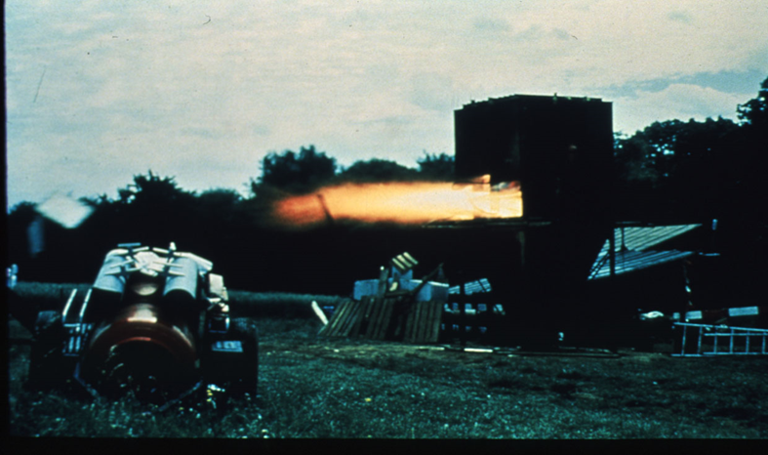
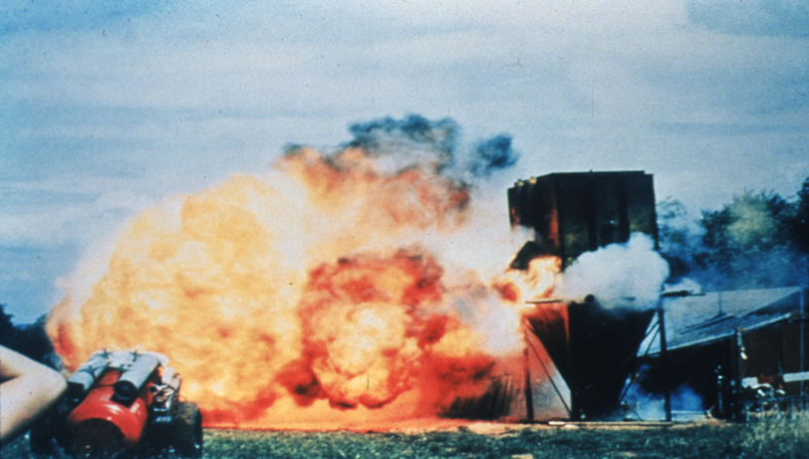
Secondary explosions
Dust is present on facility surfaces
An initial event suspends settled dust
An ignition source completes the fire triangle
Unburned dust is pushed ahead of the flame front by the pressure front in all possible directions, suspending more dust
Second explosion occurs, often much larger
Can occur inside equipment and in open areas
Dust layers over 1/64 inch thick can suspend to optimum explosible concentrations

Slide 11
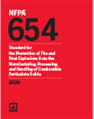
Key References
NFPA 652 – Standard on the Fundamentals of Combustible Dust
NFPA 654 – Standard for the Prevention of Fire and Dust Explosions from the Manufacturing, Processing, and Handling of Combustible Particulate Solids

Slide 12
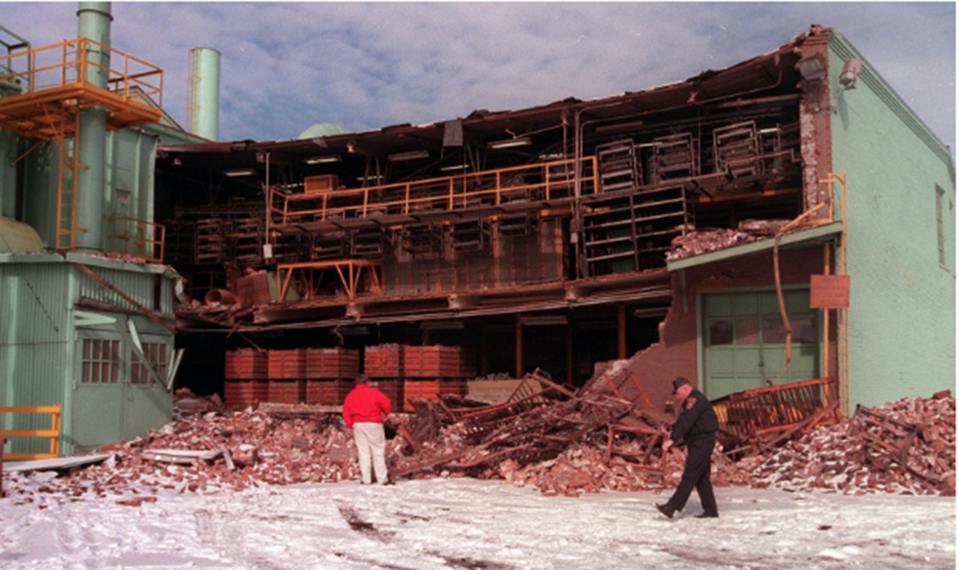
We’ve been doing it this way for 30-years…
Relative infrequency of dust explosions
Address credibility issues
Use incidents to trigger action
Demos can be persuasive, but be careful not to model risky behavior

Slide 13
Prevention
Dust Hazard Analysis
Process Equipment
Explosion relief
Isolation
Controlling oxygen or explosion containment may be feasible in some applications
Focus houskeeping efforts on preventing accumulations of dust-sized particles
Manage sources of ignition
Open flames
Static discharge
Electrical equipment (Class 2)
Hot surfaces

Slide 14
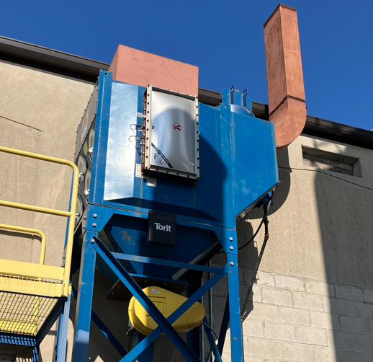
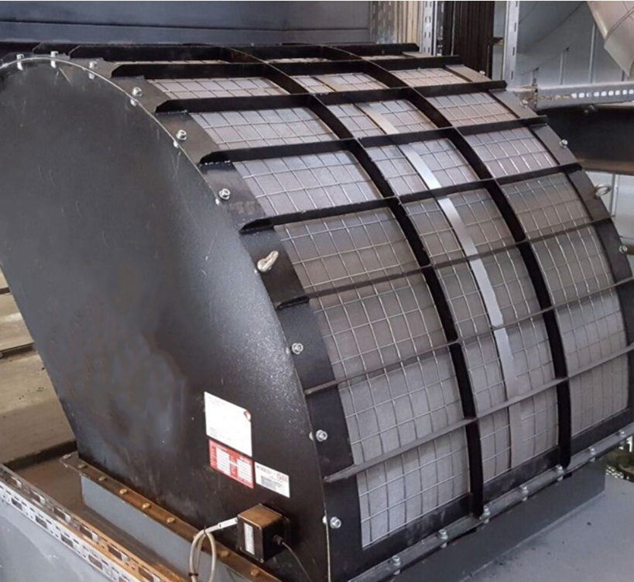
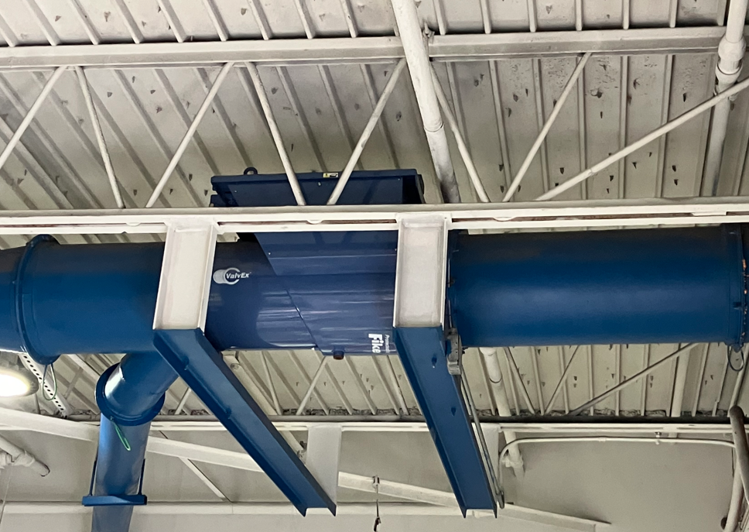
Dust collectors and bucket elevators
Basic requirements
Outside building or flameless vent
Explosion relief panels
Explosion Isolation Valve

Slide 15
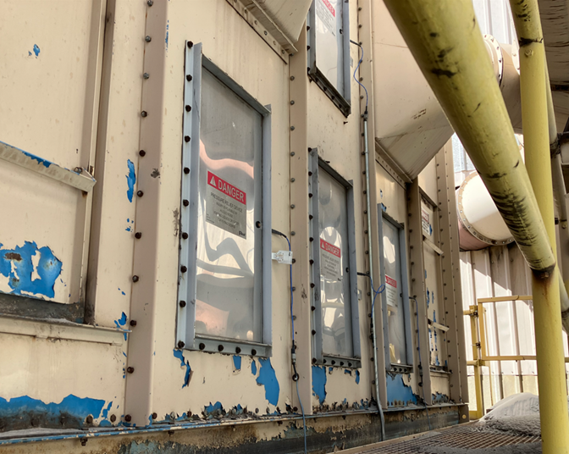
Retrofitting dust collectors
Select relief vents to fit between reinforcing ribs for easy installation
Consider pneumatic nibbler and punches to allow installation without rebagging

Slide 16
Housekeeping
Manage accumulations
Consider painting flooring surfaces to highlight visible dust
Should always be able to see the floor color
Never “blow down” the process
Use vacuum systems rated for combustible dusts, or hand brushes & brooms
Consider fixed vacuum systems for areas requiring frequent cleaning
Go after dust escape points aggressively

Slide 17
Worker training topics
Hazard awareness
Preventive measures
Inspection & reporting
Housekeeping methods
Special firefighting considerations
Fire extinguishers may suspend settled dust

Slide 18
Questions or comments?

