Slide 1
Marijuana and Opioids in the Workplace
CRV AIHA
March 3, 2020
David S. Jaffe, Vice President, Legal Advocacy
National Association of Home Builders

Slide 2
What is Marijuana
Marijuana, which can also be called weed, pot, dope, or cannabis, is the dried flowers and leaves of the cannabis plant.
It contains mind-altering (e.g., psychoactive) compounds like tetrahydrocannabinol, or THC, as well as other active compounds like cannabidiol or CBD, that are not mind-altering.
Source: Centers for Disease Control and Prevention

Slide 3
Marijuana is Illegal Under Federal Law
Marijuana is a Schedule 1 controlled substance under the Controlled Substances Act (CSA)
Schedule 1 drugs and substances are defined as drugs with no currently accepted medical use in treatment and high potential for abuse
As such, the CSA makes it a federal crime to use, possess, or distribute marijuana

Slide 4
Modes of Ingestion/Use Currently Available Medical Cannabis
Vaporizers – inhale mist
Edibles - Eat
Topicals & Sprays – apply to skin
Pills
Liquid Extracts/Tinctures – place under tongue
Plant

Slide 5
Marijuana Addiction
Contrary to popular belief, marijuana is addictive. Research shows that:
1-in-6 people who start using the drug before the age of 18 can become addicted.
1-in-10 adults who use the drug can become addicted.
Source: Substance Abuse and Mental Health Services Administration (SAMHSA)

Slide 6
Why Employers Should Care
How Cannabis affects the body:
disorientation,
impaired judgment,
lack of concentration,
slowed fine motor skills,
delayed decision-making

Slide 7
Why Employers Should Care
Employees who tested positive for cannabis had:
55% more industrial incidents
85% more injuries
75% greater absenteeism compared to those who tested negative.

Slide 8
Legalization of Marijuana
Marijuana is legal for medical use in 33 states, the District of Columbia, Guam and Puerto Rico.
Connecticut allows the use of marijuana for medical reasons.
This conflict with federal law presents new and unique challenges for employers.

Slide 9
Legalization of Marijuana
Recreational use of marijuana is now legal in 11 states and the District of Columbia.
States generally limit use to adults 21 years and older and restrict authorized amounts.
In states where recreational cannabis has been legalized, adult consumers do not need a medical marijuana card, but may not have access to the same medical cannabis products that are available for patients.

Slide 10
Marijuana in Connecticut
Recreational Use of Marijuana is Decriminalized
In general, decriminalization means no prison time or criminal record for first-time possession of a small amount for personal use.
However, recreational use and possession is still prohibited.
Legislative leaders and Gov. Ned Lamont have made it clear that they intend to make a stronger push for legalization in 2020.

Slide 11
More Employees Are Testing Positive for Marijuana at Work
Marijuana is the most commonly used illegal substance in the U.S.
One third of U.S. industry sectors, including construction, experienced year-over-year double-digit increases in workforce drug positivity between 2015 and 2018.
Increases in positivity rates for marijuana in the general U.S. workforce were most striking in states that have enacted recreational use statues since 2016.
“While it is too early to tell if this is a trend, our data suggests that the recreational use of marijuana is spilling into the workforce…”
Source: Quest Diagnostics Drug Testing Index™ (May 2018)

Slide 12
The Conflict
Can employers object to their employees’ use of marijuana at work?
Can an employer refuse to hire an employee because they admitted to using medical marijuana?
Can an employer fire an employee because they fail a drug test because of medical marijuana, even if the employee was never found to be impaired?

Slide 13
The Conflict
Medical marijuana laws vary by state, and only some states include explicit employment protections for the use of medical marijuana.
May not penalize an applicant or employee solely on the basis of such applicant’s or employee’s status as a medical marijuana licensee; and
May not penalize an applicant or employee solely on the basis of a positive test for marijuana components or metabolites.*

Slide 14
Connecticut Employment-Related Issues with Medical Marijuana
Under Connecticut’s Palliative Use of Marijuana Act, Connecticut residents who are at least 18 years of age and have been diagnosed by a physician with a “debilitating medical condition” may register as “qualifying patients” with the Department of Consumer Protection. C.G.S. Sec. 21a-408
“Qualifying patients,” after obtaining a physician’s written certification for the palliative use of marijuana, shall not be subject to arrest or prosecution, penalized in any manner, including, but not limited to, being subject to any civil penalty, or denied any right or privilege…C.G.S. Sec. 21a-408a

Slide 15
Can I Regulate My Employees’ Use of Marijuana?
YES!
PUMA does not restrict an employer's ability to prohibit the use of intoxicating substances during work hours or restrict an employer's ability to discipline an employee for being under the influence of intoxicating substances during work hours.
C.G.S. Sec. 21a-408p(3)

Slide 16
Employers May Not Discriminate Against Medical Marijuana Users
“No employer may refuse to hire a person or may discharge, penalize or threaten an employee solely on the basis of such person's or employee's status as a qualifying patient…” C.G.S. Sec. 21a-408p(3)
The law does not require a person or entity to do any act that would put it in violation of federal law or cause it to lose a federal contract.

Slide 17
Legal Challenge Under PUMA
Noffsinger v. SSC Niantic Operating Company LLC (D. Conn. August 2017)
Prospective employee alleged denial of employment in violation of PUMA
Prospective employer rescinded a job offer based on positive cannabis result during pre-employment screening test
Prospective employer was aware that prospective employee suffered from Post Traumatic Stress Disorder and was a qualifying patient under PUMA

Slide 18
Legal Challenge Under PUMA
Defendant employer argued that federal law – specifically, the Controlled Substances Act, The Americans with Disabilities Act, and the Food, Drug, and Cosmetic Act - precluded enforcement of PUMA
Holding: Federal law did not preempt (conflict with) PUMA’s antidiscrimination provision and an individual who uses marijuana for medicinal purposes in compliance with Connecticut law may maintain a cause of action against an employer who refuses to employ her for this reason

Slide 19
Barbuto v. Advantage Sales and Marketing (Mass. 2017)
Christina Barbuto suffers from Crohn’s disease, and in accordance with Massachusetts law, legally used medical marijuana to treat her condition.
Ms. Barbuto accepted a job offer with Advantage, which required her to take a pre-employment drug test.
Before taking the test, she told the company she had Crohn’s disease and used marijuana to treat it.
After starting work, Ms. Barbuto was informed she had tested positive for marijuana, and under the company policy was terminated.

Slide 20
Barbuto, cont’d
Ms. Barbuto brought a handicap discrimination claim under Massachusetts’s anti-discrimination law for Advantage’s failure to accommodate a legal treatment for her disability, Crohn’s disease.
The Supreme Court held that, notwithstanding that marijuana was illegal under federal law, accommodation of the use of medical marijuana was not per se unreasonable and that at a minimum, Advantage should have gone through an interactive process with Ms. Barbuto to consider accommodations before terminating her.
At summary judgment or trial Advantage could offer evidence that medical marijuana was not a reasonable accommodation because it would impose an undue hardship on its business, such as significant safety risks.
However, there is no implied statutory private cause of action under the medical marijuana act.

Slide 21
Employer Points
Legalization of marijuana does not mean that employees can be impaired at work.
Employers need not accommodate marijuana use in any workplace, even if:
The employee has a medical cannabis prescription; or
The employer’s place of business is in a state that has legalized marijuana for recreational purposes
In particular, employers may choose to adopt or maintain a zero-tolerance policy and may take action against offenders.

Slide 22
Employer Points – “Safety-sensitive”
Can an employer exclude a qualifying patient from performing a safety-sensitive position based on an employer’s good faith belief that the patient is engaged in the use of marijuana?
Is having the certified medical marijuana card enough for an employer to believe than employee is using marijuana?

Slide 23
Employer Points – “Safety-sensitive”
The handling, packaging, processing, storage, disposal or transport of hazardous materials,
The operation of a motor vehicle, other vehicle, equipment, machinery or power tools,
Repairing, maintaining or monitoring the performance or operation of any equipment, machinery or manufacturing process, the malfunction or disruption of which could result in injury or property damage.

Slide 24
What Are Opioids?
Opioids are narcotics that are derived from the opium poppy or its synthetic version, and include the illegal drug heroin, synthetic opioids such as fentanyl, and pain relievers available legally by prescription.
Examples of commonly prescribed opioids include hydrocodone (e.g., Vicodin), oxycodone (e.g., OxyContin, Percocet), morphine (e.g., KADIAN®, Avinza®), and codeine.

Slide 25
The Opioid Epidemic
A staggering number of Americans are dying from overdoses attributed to prescription opioid medications
Every day, more than 130 people in the United States die after overdosing on opioids (more than 47,000 – 69.5% of all overdose deaths ) - the equivalent of a daily plane crash.
Synthetic opioids (such as fentanyl), heroin, and common opioid painkillers (like Percocet and OxyContin) top other causes of overdose

Slide 26
The Opioid Epidemic - Connecticut
Historically, Connecticut has been among the states with the highest rates of opioid-related overdose deaths.
Residents are more likely to die from unintentional drug overdose than a motor vehicle accident.
The majority of these deaths are linked to overdose of prescription opioid painkillers and illicit opioids.
Source: National Institute on Drug Abuse - https://www.drugabuse.gov/drugs-abuse/opioids/opioid-summaries-by-state/connecticut-opioid-summary
Source: https://portal.ct.gov/DPH/Health-Education-Management--Surveillance/The-Office-of-Injury-Prevention/Opioids-and-Prescription-Drug-Overdose-Prevention-Program

Slide 27
The Opioid Epidemic - Connecticut
The rate of overdose deaths in Connecticut increased from 9.9 per 100,000 residents in 2012 to 28.5 per 100,000 residents in 2018—a 221 % increase—
The greatest increase in opioid deaths was seen in cases involving synthetic opioids (mainly fentanyl): a rise from 79 deaths in 2016 to 686 in 2017.
Source: https://www.drugabuse.gov/drugs-abuse/opioids/opioid-summaries-by-state/connecticut-opioid-summary

Slide 28
The Opioid Epidemic – Connecticut County Data
A new study suggests that the US opioid epidemic is actually several different epidemics occurring at the same time
Fairfield County – Emerging Heroin
Hartford County - Opioid Syndemic
Litchfield County – Opioid Syndemic
Middlesex County - Opioid Syndemic
New Haven County – High Heroin
New London County - Opioid Syndemic
Tolland County - Synthetic+Prescription
Windham County - Opioid Syndemic
Source: The Opioid Hydra: Understanding Overdose Mortality Epidemics and Syndemics Across the Rural-Urban Continuum, Rural Sociology (2019)

Slide 29
Opioid Use and Connecticut’s Workforce
The Connecticut Department of Public Health’s Occupational Health Unit has developed a set
of recommendations that outlines a more progressive, disease-based approach to employee addiction and substance use policy development.
Companies should revise their workplace substance use policies to shift the focus from stigmatization to an emphasis on support and care.

Slide 30
Opioid Use and Connecticut’s Workforce – Recommended Policies
Early Identification of workers who may be experiencing or at risk for addiction
Instant Support for counseling and treatment of affected workers and their families
Employer flexibility with respect to time off for medical appointments, light duty, and return-to-work

Slide 31
Opioid Use and Connecticut’s Workforce – Recommended Policies, Cont’d
Regular review of progress toward recovery and adjustment to reentry into the workplace
Enlisting success by tapping into the knowledge and experience of employees who have navigated similar struggles.
Source: https://portal.ct.gov/opioidsworkplace

Slide 32
Opioid Use and Connecticut’s Workforce – Change the Script
Change the Script is a new statewide campaign that connects town leaders, healthcare professionals, treatment professionals and everyday people whose lives are affected by the crisis.
With Change the Script, people can access the resources they need to face opioid misuse and write a new story about how we deal with this issue.
Ready-to-use materials are intended to raise awareness of the risks of addiction to prescription opioids.
Source: https://portal.ct.gov/DMHAS/Prevention-Unit/Prevention-Files/Change-the-Script

Slide 33
Why Employers Should Care
Illness
Turnover
Health benefit costs
Accidents and injuries
Theft and risk of violence
Depression and suicidality
Absenteeism and presenteeism
Workers compensation and disability costs
Customer dissatisfaction with inferior products

Slide 34
What Does This Have to Do with the Home Building Industry?
Construction workers are the most likely of all occupations to use cocaine and misuse prescription opioids.*
Significantly more likely to become addicted to opioids, like prescription painkillers, than other workers in the general population.
The fatal overdose rate among construction workers is 6 times what it is in the greater population.
*Source: Center for Drug Use and HIV/HCV Research at New York University’s College of Global Health (October 2019)

Slide 35
What Does This Have to Do with the Home Building Industry?
According to a recent study, work-related injuries contribute to the rapid increase in deaths from both opioids and suicides.
An injury serious enough to lead to at least a week off of work almost tripled the combined risk of suicide and overdose death among women, and increased the risk by 50 percent among men.
Source: American Journal of Industrial Medicine (July 2019)

Slide 36
What Does This Have to Do with the Home Building Industry?
Three-quarters of those struggling with addiction to alcohol, pain medication, marijuana, and other substances are employed.
The average construction worker addicted to opioids has been on pain medications for at least six months.

Slide 37
What Does This Have to Do with the Home Building Industry?
$6.8K
Each construction worker with an untreated substance abuse disorder costs an employer $6,800 per year in excess healthcare expenses, absenteeism, and turnover costs.
$2.4K
But when a construction employee is in recovery from a substance abuse disorder, contractors save nearly $2,400 per year.
Research has confirmed that opioids are not more effective than non-opioid painkillers for most pain.
Source: Midwest Economic Policy Institute (MEPI) Economic Commentary, 2018

Slide 38
Lamont And Tong Stand With Construction Workers On Opioid Addiction Awareness

Slide 39
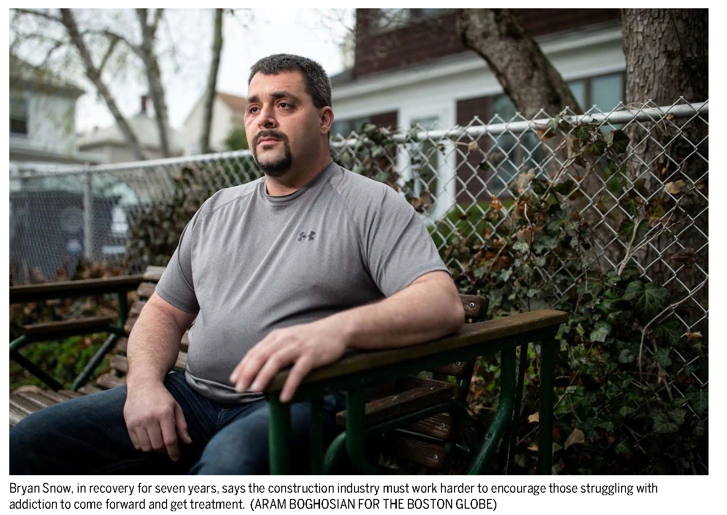
What Does This Have to Do with the Home Building Industry?
Construction industry to workers battling addiction: ‘We want to help’
By John Hilliard Globe Correspondent, April 28, 2019, 9:05 p.m.

Slide 40
P.A.A.R.I. Launches First Recovery-Friendly Construction Site Program

Slide 41
Recovery-Friendly Construction Site Program
Launched – June 2019
NARCAN training
Distribution of customized NARCAN kit – wall-mounted
Recovery support –
Reduce stigma surrounding the opioid epidemic
Help individuals connect with treatment and services

Slide 42
How Employers Can Make a Difference
Employers can take simple steps to protect themselves and their employees:
Recognize prescription drugs impact the bottom line
Enact strong company drug policies
Expand drug panel testing to include opioids
Train supervisors and employees to spot the first signs of drug misuse
Treat substance abuse as a disease
Leverage employee assistance programs to help employees return to work

Slide 43
Written Policy
A clearly written policy forms the foundation of your drug-free workplace program. At minimum, your policy should include:
The rationale for the policy, such as organizational goals and compliance with laws or regulations
Expectations for compliance, including who, what, when, and where
Assistance options to support employees in following the policy
Consequences for violating the policy

Slide 44
Drug Testing - Connecticut
Connecticut has a drug testing statute, Conn. Gen. Stat.§31-51t et seq.
Applies to any individual, corporation, partnership or association except for the state or a subdivision thereof.

Slide 45
Pre-Employment Drug Testing
Permits employers to require pre-employment urinalysis alcohol and drug tests so long as:
The prospective employee is informed in writing at the time of application of the employer's intent to conduct such a drug test
The drug test is conducted using a reliable methodology and if positive, confirmed by a second test which is separate and utilizing a gas chromatography and mass spectrometry methodology
The prospective employee is given a copy of any positive drug test result (the results shall be confidential)

Slide 46
Drug Testing of Current Employees
Permissible if –
The employer has reasonable suspicion that the employee is under the influence of drugs or alcohol which adversely affects or could adversely affect such employee's job performance.

Slide 47
Random Drug Testing of Current Employees
An employer may require an employee to submit to a urinalysis drug test on a random basis if:
Such test is authorized under federal law
The employee serves in an occupation which has been designated as a high-risk or safety-sensitive occupation pursuant to regulations adopted by the Labor Commissioner
The urinalysis is conducted as Part of an Employee Assistance Program in which the employee voluntarily participates

Slide 48
Random Drug Testing – Reasonable Suspicion
Common examples of reasonable suspicion include but are not limited to:
Irregular behavior
Substantial deterioration in work performance
Physical symptoms of drug use (uncoordinated movement, smell, etc.)
Direct observation of drug use
Report from a reliable source that an employee is using drugs
Evidence that the employee has used, possessed, sold or solicited, transferred drugs while at work

Slide 49
NAHB Resources
To learn more about the marijuana laws and their impact on the workplace NAHB has prepared the following two resources:
Dazed and Confused: The Buzz Surrounding Legalized Marijuana in the Workplace. This on-demand webinar discusses the differences between state and federal laws and examines the ways the legalization of both medical and recreational marijuana can impact the home building industry.
A Builder’s Guidebook: Marijuana in the Home Building Industry. The guide examines pertinent issues related to the legalization of marijuana, and includes a compilation of state laws, tips for creating a workplace policy and answers to frequently asked questions.

Slide 50
Opioid Resources
In 2019, after 2 years of work, NAHB completed the initial phase of its opioid initiative “Opioids in the Home Building Industry: Making it Your Business.”
It aligns with NAHB’s workplace safety objectives by offering specific education and training designed to protect the health and well-being of those involved in the industry and the related trades.
Working with experts in the field of drug abuse, we created a unique set of resources tailored specifically to the residential construction industry.

Slide 51
Opioid Resources
Our goals from the outset were to:
Raise awareness within the industry
Educate and inform builders, employees, subcontractors, and their families, and
Help them to take action.

Slide 52
Opioid Resources
Our goals from the outset were to:
Raise awareness within the industry
Educate and inform builders, employees, subcontractors, and their families, and
Help them to take action.

Slide 53
THANK YOU
David Jaffe
Vice President, Legal Advocacy
djaffe@nahb.org
800-368-5242 x8317
We Build Communitites
®

